Slide 1
Using a Microscope

Slide 2
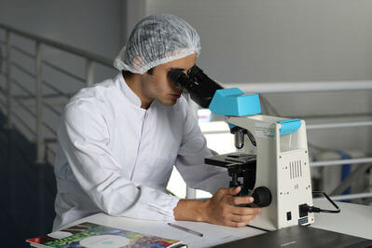
In this Smart Lesson you will be doing the following:
1. | Outlining how to set up a slide for a microscope.
2. | Outlining how to view the specimen under a microscope.

Slide 3
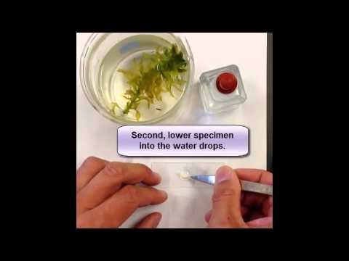

Slide 4
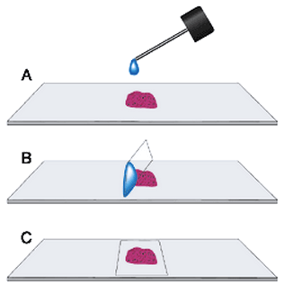
How to prepare a slide:
1. | Using an eyedropper, place a drop of water onto a clean microscope slide. If a stain is being used, then it can be added to the drop of water at this stage.
2. | Gently place the specimen into the middle of the drop of water.
Note: If it is easier, the specimen can be placed on the slide before the drop of water is added.

Slide 5
3. | Gently lower the thin glass coverslip onto the slide at a 45 degree angle, starting at the edge of the drop.
4. | Soak up any excess water or stain around the coverslip, with a piece of filter paper or tissue.

Slide 6
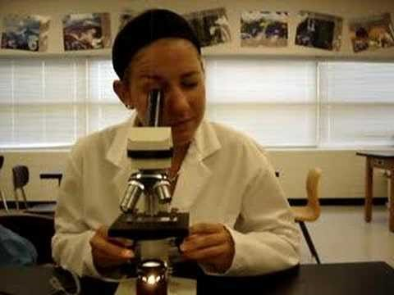

Slide 7
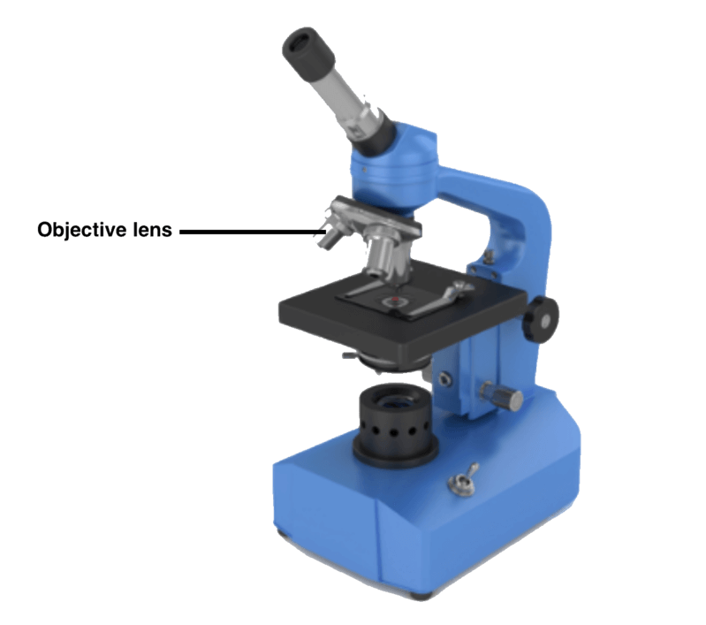
1. | Set the microscope with the lowest powered objective lens. This will most often be the lens with a magnification power of 4×.
2. | Take the prepared slide and clamp it in place on the microscope stage.

Slide 8
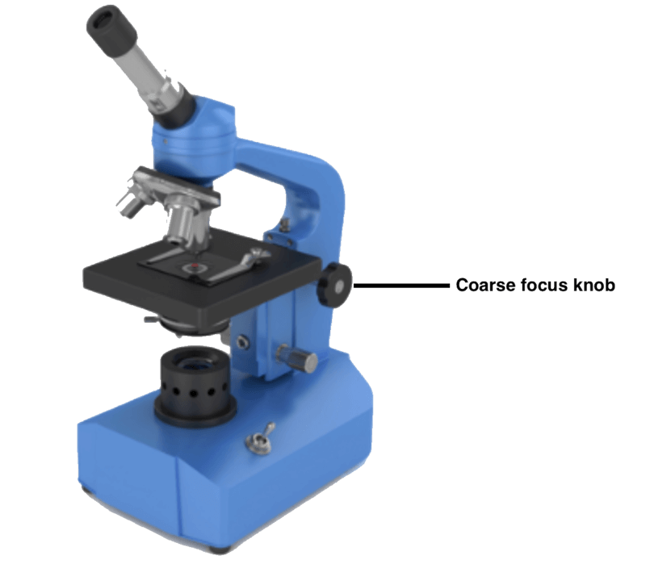
3. | Turn on the microscope and take a look through the eyepiece. Adjust the image using the coarse focus knob.
4. | To view a higher magnification, select the medium lens power and readjust using the coarse focus knob.

Slide 9
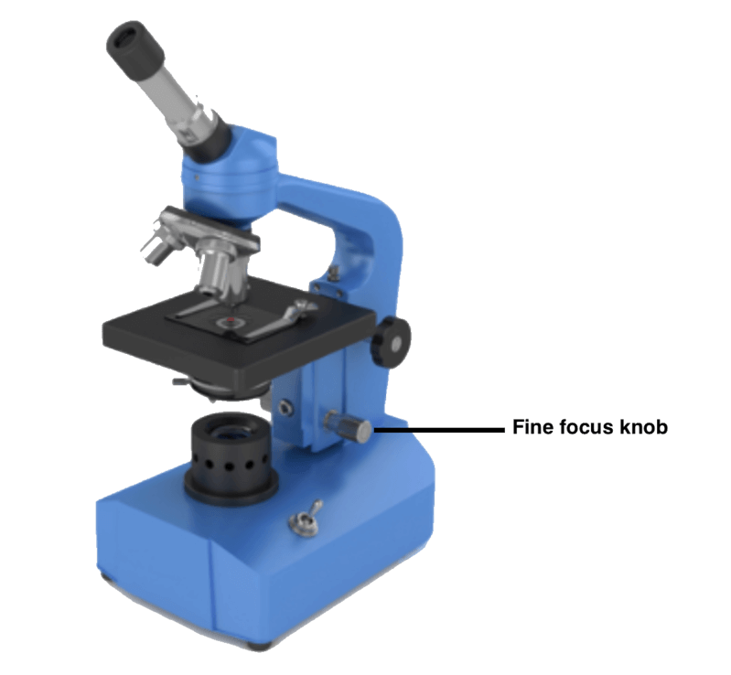
3. | Turn on the microscope and take a look through the eyepiece. Adjust the image using the coarse focus knob.
4. | To view a higher magnification, select the medium lens power and readjust using the coarse focus knob.

